Slide 1

Graphs
Data Structures
Dr. Bouchaib Falah

Slide 2
The Graph ADT - Introduction
The most used Structure in Mathematics and Computer science
Sample Applications:
Modeling maps
Routing - Finding shortest paths
Electrical Circuits
Compilers – (Automata) ….

Slide 3
Applications
electronic circuits
networks (roads, flights, communications)
CSC2302
JFK
LAX
LAX
STL
HNL
DFW
FTL

Slide 4
The ’Koenigsberg Bridge Problem’
The first recorded evidence of the use of graphs backs to 1736 – Leonhard Euler
The ’Koenigsberg Bridge Problem’
Problem Description:
Four lands (A – D) (including an Island)
Seven Bridges (1 – 7)
Starting at some land area, is it possible to return to the starting land after walking across all bridges exactly once?

Slide 5
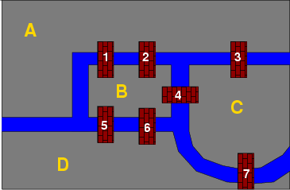
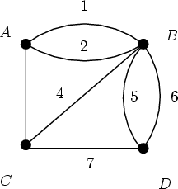
The ’Koenigsberg Bridge Problem’

Slide 6
The ’Koenigsberg Bridge Problem’
Euler tried to solve the problem using a graph where each ‘Land Area’ is represented by a ‘Vertex’ and each bridge is represented by an ‘Edge’
See Corresponding graph in previous slide
Euler discovered that the people of ‘Koenigsberg’ cannot do it!
His solution applies to all graphs! – Graph Theory!
Defining the ‘In-Degree’ of a ‘Vertex’ as the number of edges entering it, he proved that such a walk -‘Eulerian Walk’ - can be done only iff the ‘In-Degree’ for all vertices is Even!

Slide 7
What is a Graph?
A graph G = (V,E) is composed of:
V: set of vertices
E: set of edges connecting the vertices in V
An edge e = (u,v) is a pair of vertices
Example:
a
b
V= {a,b,c,d,e}
E= {(a,b),(a,c),(a,d), (b,e), (c,d),(c,e), (d,e)}
c
d
e

Slide 8
Graphs - Definitions
Any graph G, consists of 2 sets:
V(G): finite, nonempty set of ‘Vertices’
E(G): finite, possibly empty set of ‘Edges’
We write  G = (V, E)
Two basic types of graphs:
UnDirected: any pair of vertices (v1, v2) representing an edge is unordered. I.e, (v1, v2) and (v2, v1) represent the same edge. Example: The Koenigsberg graph.
Directed – ‘Digraphs’: each edge is represented as a directed pair of vertices (A directed graph is one in which edges connect vertices in only one direction.
Complete Graphs: graphs where each pair of vertices is adjacent/linked

Slide 9
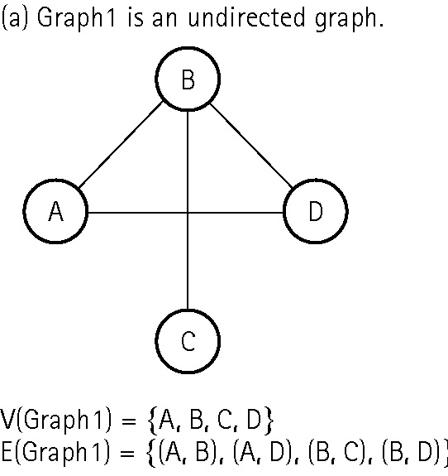
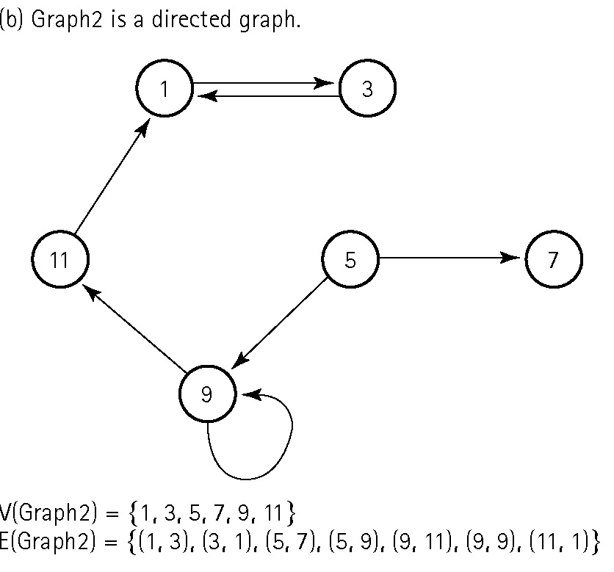
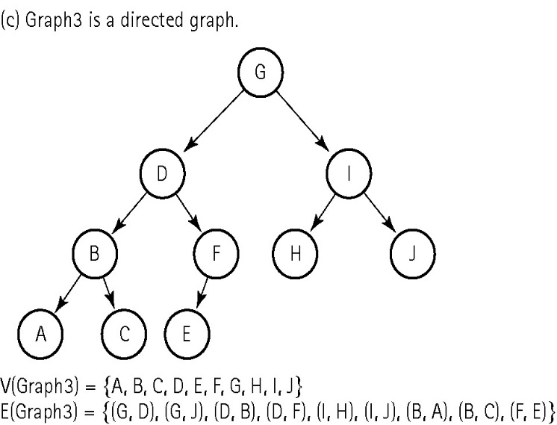
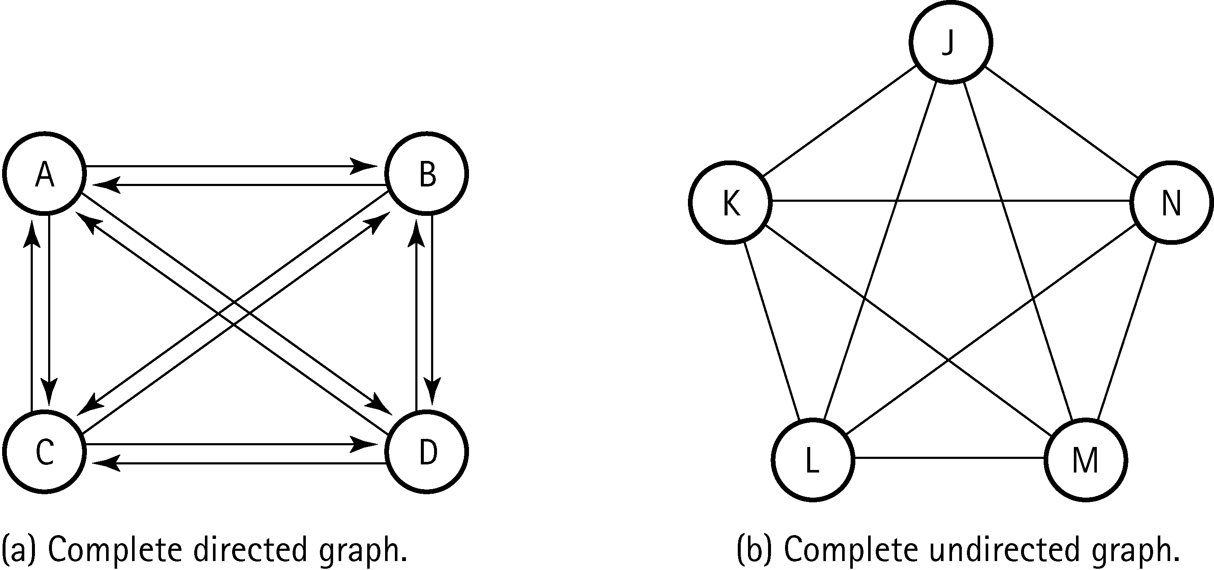

Slide 10
Graphs – Definitions (Cont.)
Path: any sequence of ‘Edges’ that connect 2 vertices
Adjacency Set: Given an ‘Edge’ <s,d>, d is adjacent to s. The set of all nodes adjacent to s is called the ‘Adjacency Set’ of s
In-Degree/Out-Degree of a vertex: The number of edges entering/leaving a node
Weighted Graphs: graphs where ‘Edges’ are assigned values called ‘Weights’. These later represent the ‘Cost’ associated with an edge. I.e, ‘Distances’ in a Map Graph
Connected Graphs: for every 2 vertices there exist at least one path
Cycle: a path such as the destination of the last edge is the source of the first edge
A self-loop is a cycle of length 1
Acyclic graphs: graphs with no cycles. Exp: Trees

Slide 11
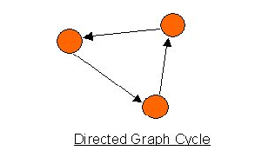
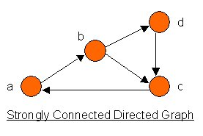
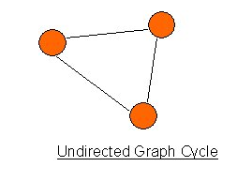
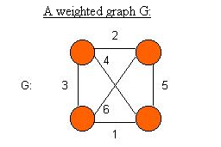
Graphs – Definitions (Cont.)

Slide 12
Terminology: Degree of a Vertex
The degree of a vertex is the number of edges incident to that vertex
if di is the degree of a vertex i in a undirected graph G with n vertices and e edges, the number of edges is
For directed graph,
the in-degree of a vertex v is the number of edges that have v as the head
the out-degree of a vertex v is the number of edges that have v as the tail
tail
head
Why? Since adjacent vertices each
count the adjoining edge, it will be
counted twice

Slide 13
Examples of In-Out Degree
0
3
2
0
1
2
3
3
3
1
2
3
3
4
5
6
3
1
1
1
1
3
0
in:1, out: 1
directed graph
in-degree
out-degree
1
in: 1, out: 2
2
in: 1, out: 0

Slide 14
Graphs as an ADT
Now that we are done with definitions/terminology of the ‘Graph ADT’, we are still left with defining the operations set.
Basically:
addVertex(vertex v)
addEdge(vertex start, vertex end)
getPath(vertex v1, vertex v2)
traverseGraph(vertex v)
getAdjacent(v)
isConnected(v1, v2)

Slide 15
Graph Representations The Data Structure!
Heretofore, Graphs are still an ‘Abstraction’. How can we use graphs to model problems? In Other words how can we represent graphs? I.e. the ‘Data Structure’!
There are 2 representations:
Adjacency Matrix
Adjacency List

Slide 16
Graph Representation Adjacency Matrix
Let G=(V,E) be a graph with n vertices.
The adjacency matrix of G is a two-dimensional n by n array, say adj_mat
If the edge (vi, vj) is in E(G), adj_mat[i][j]=1
If there is no such edge in E(G), adj_mat[i][j]=0
The array is a N*N one where N = |V|
The adjacency matrix for an undirected graph is symmetric; the adjacency matrix for a digraph need not be symmetric

Slide 17
Example of Adjacency Matrix
4
G3
G1
0
5
0
0
6
2
1
1
1
2
3
7
3
2
G2
symmetric

Slide 18
Adjacency Matrix (Cont.)
In a Digraph, the row sum is the ‘Out-Degree’, and the column sum is the ‘In-Degree’
In an Undirected graph, the ‘Degree’ of a vertex is the row sum
In a ‘Weighted Graphs’, the bits (0/1) are replaced by the corresponding ‘Costs’!

Slide 19
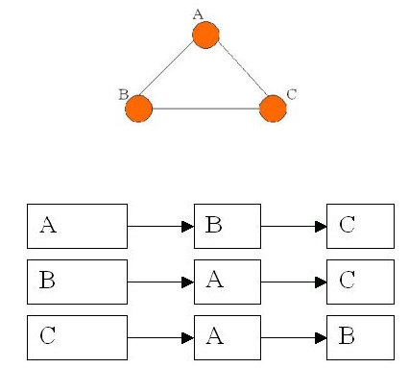
Graphs Adjacency List
Each row in adjacency matrix is represented as an adjacency list.
An array of N head pointers to linked lists
Each array element A[i], represents one vertex and points to a linked list of its ‘Adjacent Vertices’
Interpret this linked list as meaning: there are edges from A to B and from A to C.

Slide 20
Adjacency List Example
0
1
2
3
1
2
3
0
0
2
3
1
2
0
1
3
0
1
2
3
0
G1
0
1
2
1
1
0
2
G2
2
An undirected graph with n vertices and e edges ==> n head nodes and 2e list nodes

Slide 21
Adjacency List Example
0
1
2
3
4
5
6
7
1
2
0
3
0
4
0
3
2
1
5
1
2
3
6
5
7
4
6
5
7
6
G3
An undirected graph with n vertices and e edges ==> n head nodes and 2e list nodes

Slide 22
Graph Traversals
Like trees, there are traversals. BUT, unlike trees, there is no Root!
First  Fix a ‘Starting Node’
Traversal is the most important operation as it solves many questions!
Given any vertex V, we want to ‘Visit’ all accessible nodes. Hence, we can answer:
Can I get from a vertex to another? ‘How’?
Is a graph connected? ‘How’?
What is the best road? ‘How? Shortest Path?

Slide 23
Graph Traversals
Problem: Search for a certain node or traverse all nodes in the graph
Two common methods:
Depth First Search (DFS)
Once a possible path is found, continue the search until the end of the path
Breadth First Search (BFS)
Start several paths at a time, and advance in each one step at a time

Slide 24
Graph Traversals DFS – Think Stack
Fix a Starting Vertex v
Algorithm – DFS(G, v):
If not visited - Visit/Print v then mark as visited
Loop through the adjacent vertices:
Apply DFS
A stack is used to keep track of the ‘Adjacency Lists’!
When you reach a vertex with no ‘Unvisited’ vertices, the vertex is removed from the stack and its adjacency list is processed
The search terminates when the stack is empty

Slide 25
DFS Example
F
Stack:
Visited Vertices :
C
B
H
A
D
E
G

Slide 26
DFS Example
F
Stack: A
Visited Vertices : A
C
B
H
A
D
E
G

Slide 27
DFS Example
F
B
Stack: A
Visited Vertices : A B
C
B
H
A
D
E
G

Slide 28
DFS Example
F
E
B
Stack: A
Visited Vertices : A B E
C
B
H
A
D
E
G

Slide 29
DFS Example
F
G
E
B
Stack: A
Visited Vertices : A B E G
C
B
H
A
D
E
G

Slide 30
DFS Example
F
E
B
Stack: A
Visited Vertices : A B E G
C
B
H
A
D
E
G

Slide 31
DFS Example
F
B
Stack: A
Visited Vertices : A B E G
C
B
H
A
D
E
G

Slide 32
DFS Example
F
F
B
Stack: A
Visited Vertices : A B E G F
C
B
H
A
D
E
G

Slide 33
DFS Example
F
C
F
B
Stack: A
Visited Vertices : A B E G F C
C
B
H
A
D
E
G

Slide 34
DFS Example
F
H
C
F
B
Stack: A
Visited Vertices : A B E G F C H
C
B
H
A
D
E
G

Slide 35
DFS Example
F
C
F
B
Stack: A
Visited Vertices : A B E G F C H
C
B
H
A
D
E
G

Slide 36
DFS Example
F
F
B
Stack: A
Visited Vertices : A B E G F C H
C
B
H
A
D
E
G

Slide 37
DFS Example
F
D
F
B
Stack: A
Visited Vertices : A B E G F C H D
C
B
H
A
D
E
G

Slide 38
DFS Example
F
F
B
Stack: A
Visited Vertices : A B E G F C H D
C
B
H
A
D
E
G

Slide 39
DFS Example
F
B
Stack: A
Visited Vertices : A B E G F C H D
C
B
H
A
D
E
G

Slide 40
DFS Example
F
Stack: A
Visited Vertices : A B E G F C H D
C
B
H
A
D
E
G

Slide 41
DFS Example
F
DFS Traversal is complete
Stack:
Visited Vertices : A B E G F C H D
C
B
H
A
D
E
G

Slide 42
DFS - Iteratively
Void dfs(int v) {
push(v);
While(stack not empty) {
v = pop();
If (! Visited[v])
Print & mark as visited;
For (each w in v’s adjacency list)
If (!Visited[w])
push(w);
}
}  O(n²)

Slide 43
Graph Traversals BFS – think queue
Algorithm – BFS(G, v):
Visit the v’s adjacency list
Visit the adjacency list of the first vertix in v’s list
Do the same with other vertices in v’s adjacency list
A queue is used to keep tack of a vertrex’s adjacency list
When a vertex is dequeued, its adjacency list is enqueued
V is enqueued at first instance, then dequeued
The search stops when the queue is empty

Slide 44
BFS Example
F
Queue:
Visited Vertices :
C
B
H
A
D
E
G

Slide 45
BFS Example
F
Queue:
Visited Vertices : A
C
B
H
A
D
E
G

Slide 46
BFS Example
F
Queue: B
Visited Vertices : A B
C
B
H
A
D
E
G

Slide 47
BFS Example
F
Queue: B
D
Visited Vertices : A B D
C
B
H
A
D
E
G

Slide 48
BFS Example
F
Queue: B
D
G
Visited Vertices : A B D G
C
B
H
A
D
E
G

Slide 49
BFS Example
F
Queue: B
D
G
Visited Vertices : A B D G
C
B
H
A
D
E
G

Slide 50
BFS Example
F
Queue: B
D
G
E
Visited Vertices : A B D G E
C
B
H
A
D
E
G

Slide 51
BFS Example
F
Queue: B
D
G
E
F
Visited Vertices : A B D G E F
C
B
H
A
D
E
G

Slide 52
BFS Example
F
Queue: B
D
G
E
F
Visited Vertices : A B D G E F
C
B
H
A
D
E
G

Slide 53
BFS Example
F
Queue: B
D
G
E
F
Visited Vertices : A B D G E F
C
B
H
A
D
E
G

Slide 54
BFS Example
F
Queue: B
D
G
E
F
Visited Vertices : A B D G E F
C
B
H
A
D
E
G

Slide 55
BFS Example
F
Queue: B
D
G
E
F
Visited Vertices : A B D G E F
C
B
H
A
D
E
G

Slide 56
BFS Example
F
Queue: B
D
G
E
F
C
Visited Vertices : A B D G E F C
C
B
H
A
D
E
G

Slide 57
BFS Example
F
Queue: B
D
G
E
F
C
Visited Vertices : A B D G E F C
C
B
H
A
D
E
G

Slide 58
BFS Example
F
Queue: B
D
G
E
F
C
H
Visited Vertices : A B D G E F C H
C
B
H
A
D
E
G

Slide 59
BFS Example
F
BFS Traversal is complete
Queue: B
D
G
E
F
C
H
Visited Vertices : A B D G E F C H
C
B
H
A
D
E
G

Slide 60
Exercise
Consider the following directed graph:
0
7
6
3
5
1
4
2

Slide 61
Exercise. Cont.
Implement DFS traversal recursively
Print the graph showing the edges of each vertex.
Print the list of DFS traversal starting from each vertex.
Refer to the screen shot in the next slide to execute your program

Slide 62
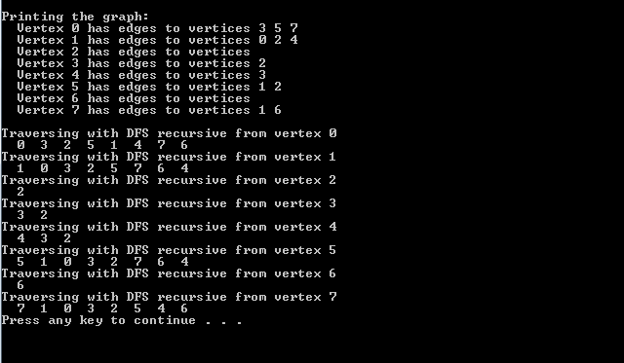
Exercise. Cont.

